Slide 1
TITLE By Corey Crooks September 28, 2022 IT302—Human Computer Interaction Unit 5

Slide 2
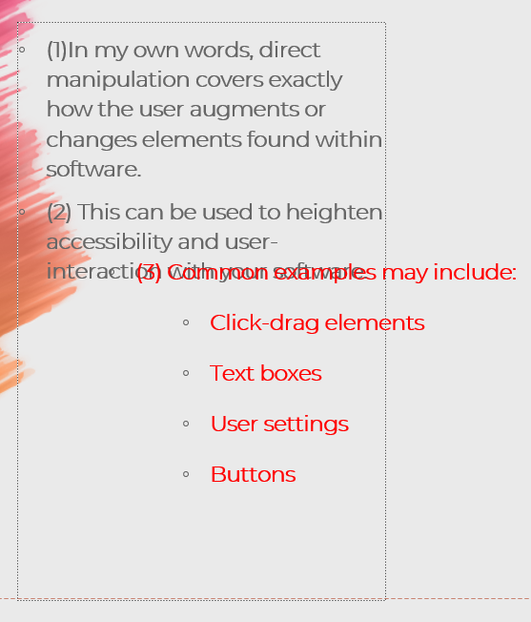
Direct Manipulation
(1)In my own words, direct manipulation covers exactly how the user augments or changes elements found within software.
(2) This can be used to heighten accessibility and user-interaction with your software.
(4)
(3) Common examples may include:
Click-drag elements
Text boxes
User settings
Buttons

Slide 3
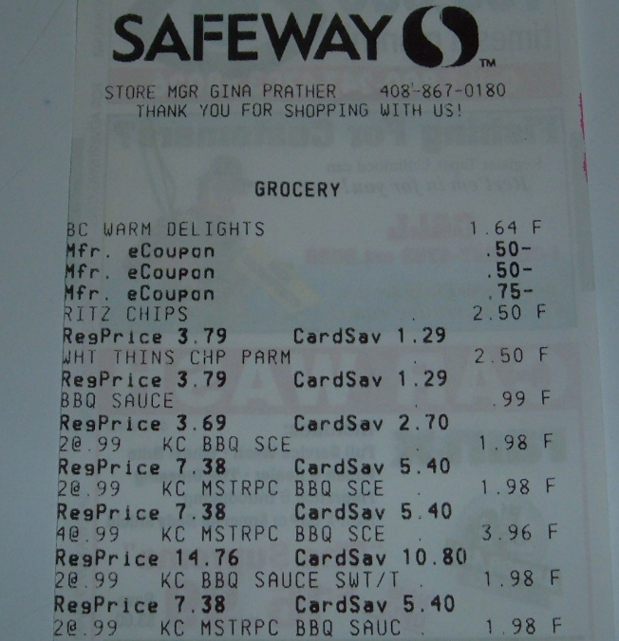
Long Lists
(1) In my own words, long lists include information organized sequentially that provides the user with insight into a particular topic or topics.
(2) This can be used to give the user a sense of awareness about the disciplines they relate to. It can show up in forms such as a drop-down list, a stacked list, a horizontal list, and many more.
(3) Examples include purchase receipts. During these receipts, you may have a number of bits of information such as time, place, order composition, and much more.
(4)
Day 67 Safeway Receipt (2022). Grocery Coupon Guide

Slide 4
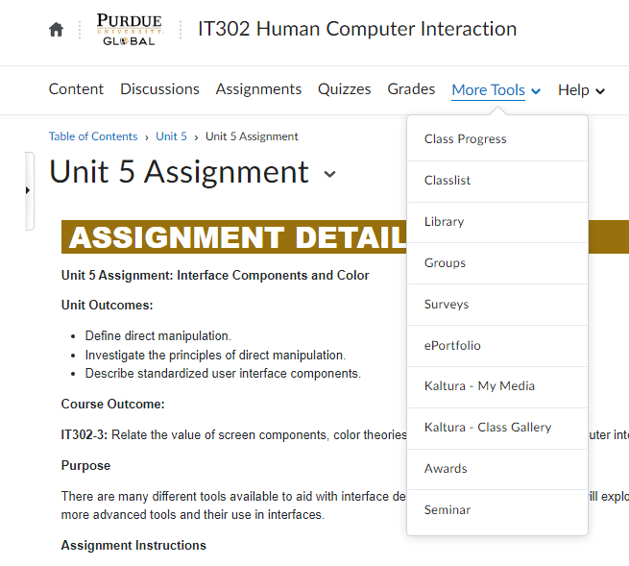
Pop-Up Menus
(1) In my own words, pop-up menus are design elements that appear to capture a user’s attention. They usually appear on hover or click.
(2) Pop-up menus can be used to divert a user’s attention to a particular element such as a notice, an advertisement, or another important element. They can also expand options of a given button or tab.
(3) Typical examples include enhanced options of navigation menus for websites.
(4)

Slide 5
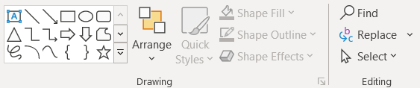
Toolbars
(1) In my own words, toolbars are elements that house a number of action-related buttons to enhance user control over the content they’re developing.
(2) This can be used to provide an organized space for manipulators, and allow the user an enhanced method of direct manipulation
(3) Common examples of toolbars would include the overhead-ribbon, or the Photoshop tool selector strip.
(4)

Slide 6
Virtual Reality
(1) In my own words, Virtual Reality details a digital construction of an environment. Strictly speaking, this is not referring to Augmented Reality applications such as phone games that inject images into the environment through the camera of the smartphone. Virtual Reality requires a headset/lenses and a completely manufactured environment.
(2) Forms of this include experiences that do not require user interaction and are simply akin to a “VR rollercoaster”. It could also involve Videogames that take user input to control a virtual character to interact with other players.
(3) One example of this would be the popular VR Shooter, Pavlov VR. In this SteamVR or Quest 2 game, the user uses controllers found on the headset to manipulate firearms in a number of game modes.

Slide 7
Good Colour Usage
https://www.Xbox.com/en-US/
(2) The colour scheme used in Xbox’s home website serves a number of purposes. For starters, using strictly white and dark green for the website elements like buttons and sections serves to highlight the other splashes of colour found in the website. In this case, the other colours are found within advertisements for videogames they sell. This puts the focus on the products while also maintaining the classic Xbox green to help the site remain consistent and immediately recognizable.
(3) The colour found on Xbox’s site mitigates this problem by making organizational elements clear, but the website as a whole consists of a number of haphazardly introduced boxes with no real flow, making precise navigation difficult. It seems to have no real structure, and simply puts navigation boxes and buttons just to fill the screen. I would recommend reorganizing the layout of the site, as well as introducing non-green colours for accents to highlight important navigational tools.

Slide 8
Poor Colour Usage
This Power-Point
(2) You may have noticed already, but I have intentionally used a poor colour design in this Power-Point in order to highlight effective tools. Colour typically is used as a way of organization. It ties the work together while highlighting aspects that may be important. In this Power-Point, colours used on slides 2-6 have been used to highlight non-unique information while slides 7 and 8’s colour has been used inappropriately by choosing arbitrary colour.
(3) To better use colour in this slideshow, slides 2-6 could feature bullet points in which the headers of each section would have a unique colour to the body of the paragraph. For instance, the numbers could be a deeper black to highlight the organization. Slide 7 could feature the Xbox green in the URL with “xbox.com” while the rest of the URL could be black to highlight the name of the website within the URL. This slide could feature red as an accent colour to give the distinction between green of the previous slide (good) and red of this one (bad).

Slide 9
Making an Effective User Interface
Effective User interfaces take an immense amount of work to perfect. Designers need to consider the requirements of all their users, and accommodate for any anticipated problems. Moreover, they should remain consistent with common design techniques of today in order to ensure users do not have to commit to learning a new complicated design language, and can use the tools and principals they’re already familiar with to help mitigate any struggles and learning curve for your program.

Slide 10
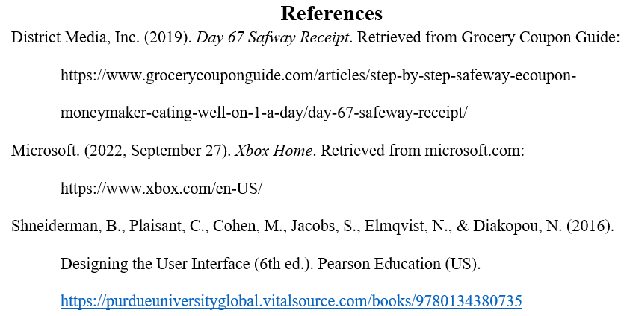

Slide 11
This Power-Point template:
Name of Site:
Name of Template:
Full URL to Template:
Slide Carnival
Colorful Brush Strokes
https://www.slidescarnival.com/juliet-free-presentation-template/3373

